Slide 1
A protein inventory reveals mechanisms of temperature impact on oyster development
Shelly Trigg, Ph.D.
Steven Roberts Lab, School of Aquatic and Fishery Sciences
University of Washington, Seattle, WA

Slide 2




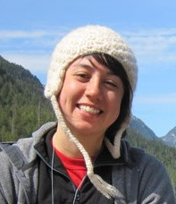
Acknowledgements
Benoit Eudeline
Award NA140AR4170078
Project R/SFA-8
Kaitlyn Mitchell
Rhonda Elliot
Emma Timmins-Schiffman
Brent Valdopalas
Steven
Roberts lab members
Notes:
I am a postdoctoral researcher in Steven Roberts lab, started last year. This was started by Rhonda Elliot a former gradate student in collaboration with Taylor Shellfish.

Slide 3
Background
Oyster juvenile development in aquaculture → crash cultures
Higher temperatures have shown less crashing, but we don’t know why
Questions
What does normal juvenile development looks like at the molecular level?
How does temperature affect juvenile development at the molecular level?

Slide 4
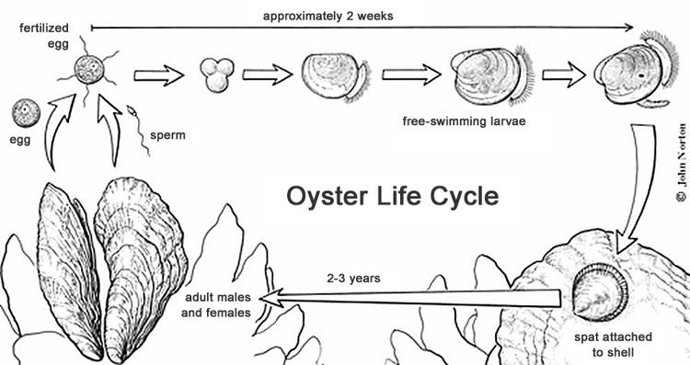
Experiment
timeline
proteomics
23°C
29°C

Slide 5
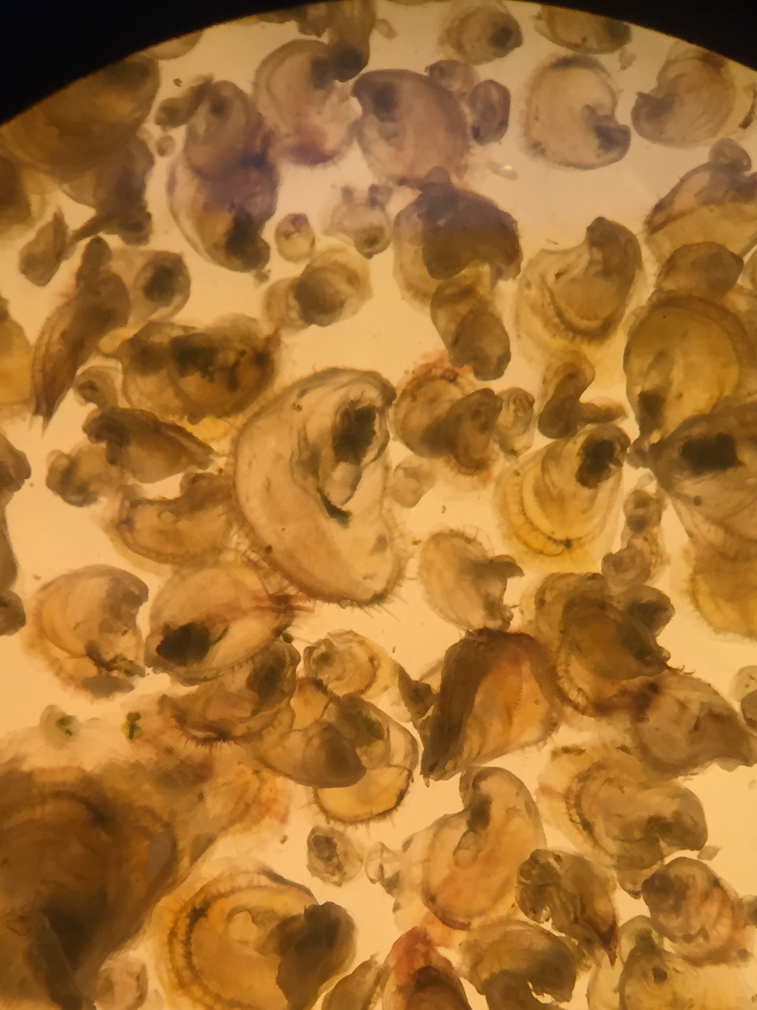
Proteomics overview

Slide 6
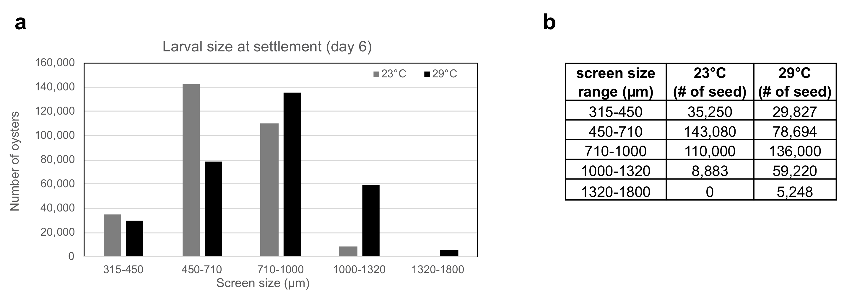
Results
No statistically significant difference in survival
Statistically significant difference in size
29C has more animals of larger size

Slide 7
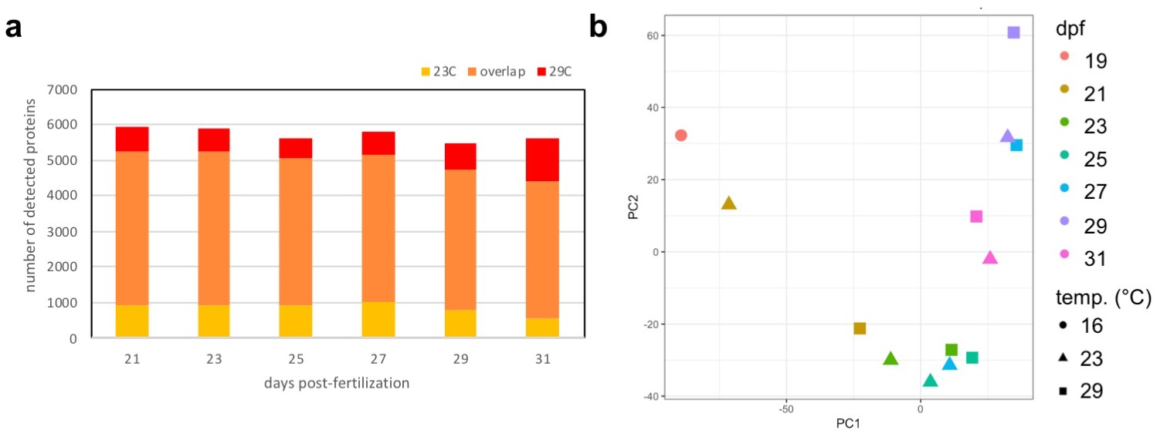
Results

Slide 8
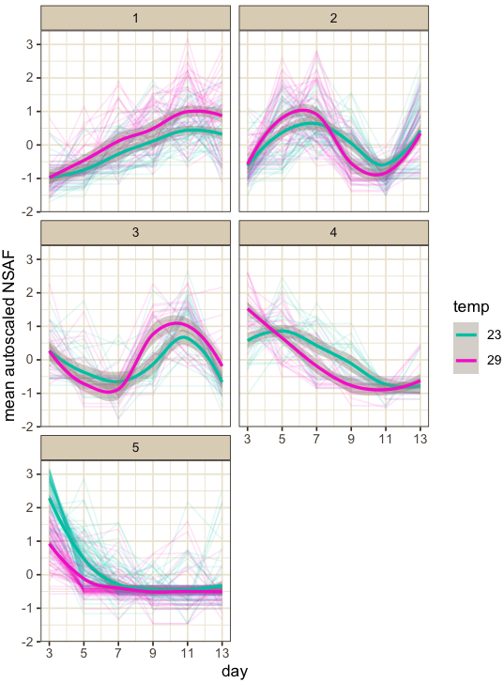
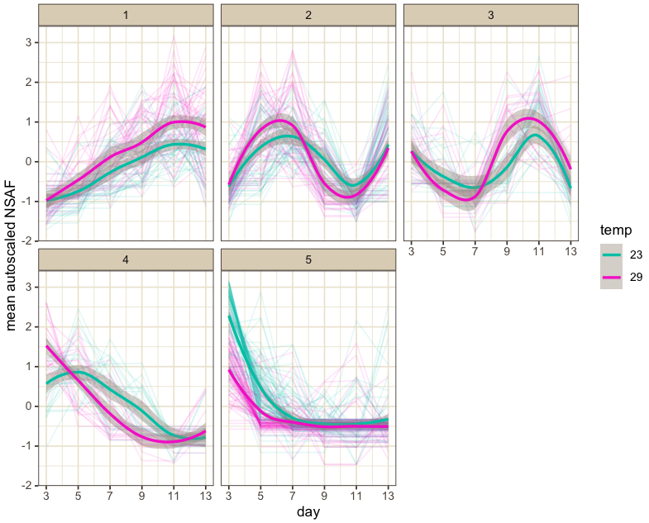
Results: proteins significantly affected by time
Proteins that commonly change over time

Slide 9
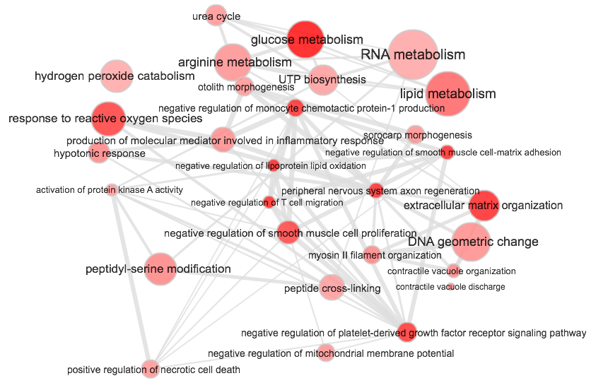
Results: biological processes significantly affected by time
Clade 5

Slide 10
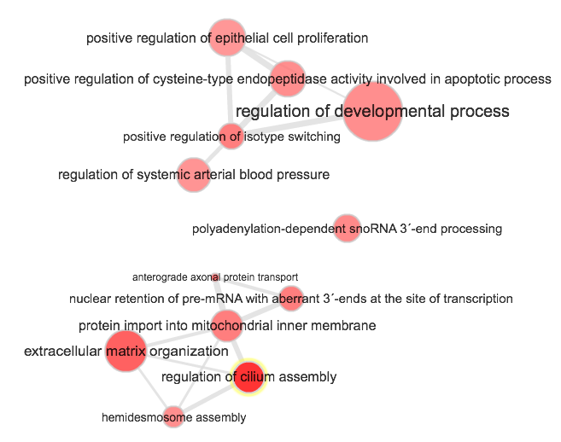
Results: biological processes significantly affected by time
Clade 4

Slide 11
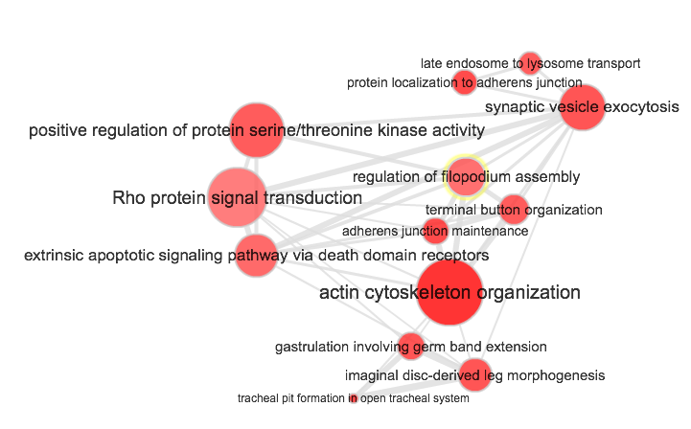
Results: biological processes significantly affected by time
Clade 3

Slide 12
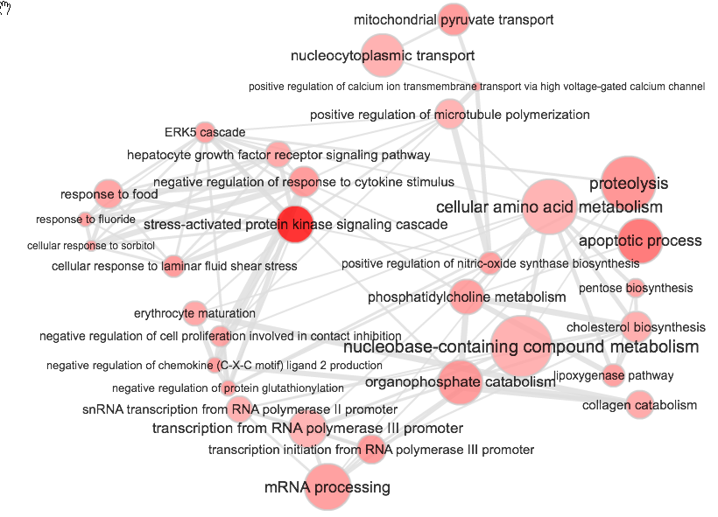
Results: biological processes significantly affected by time
Clade 2

Slide 13
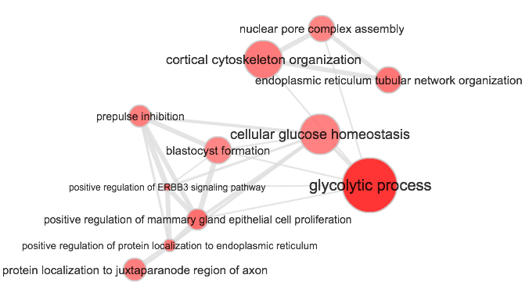
Results: biological processes significantly affected by time
Clade 1

Slide 14
5
4
2
1
3

Slide 15
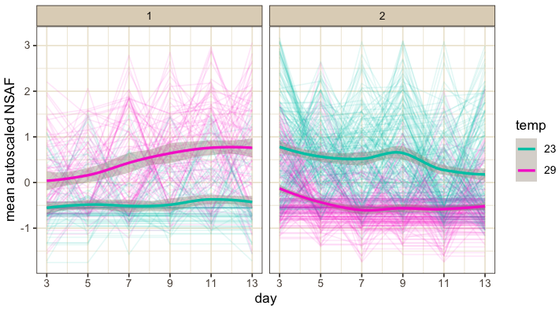
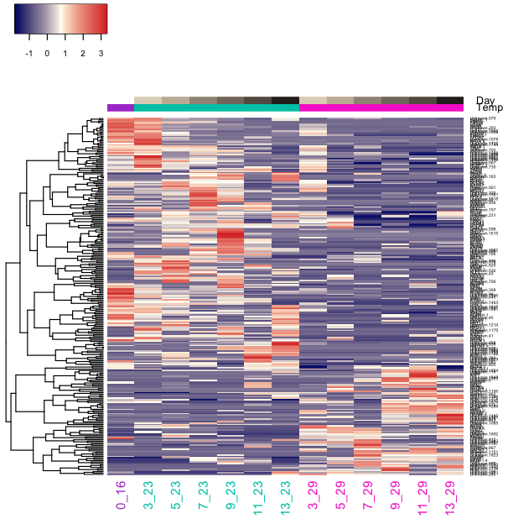
Results: proteins significantly affected by silo at 23C
Clade 1
Clade 2

Slide 16
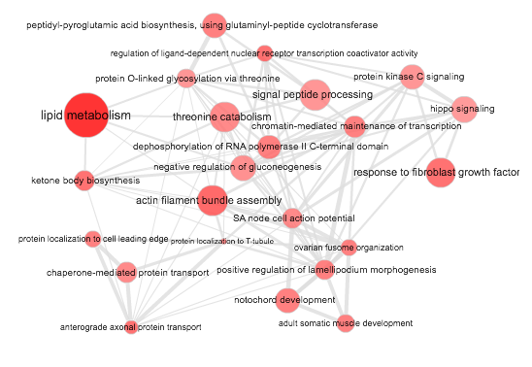
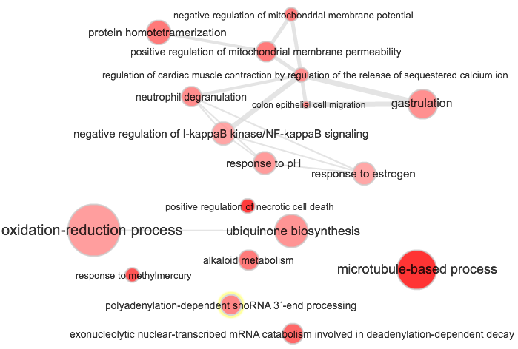
Results: biological processes enriched at 29C
clade 1
clade 2
Up-regulated processes:
Down-regulated processes:

Slide 17
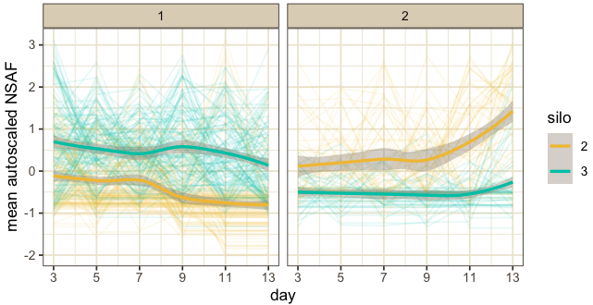
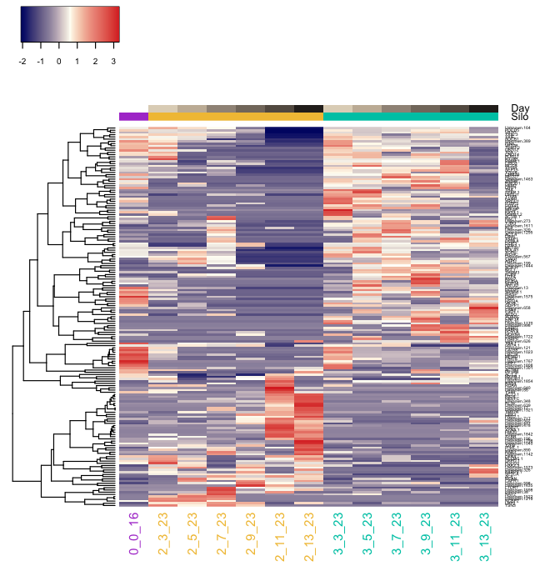
Results: proteins significantly affected by silo at 23C
Clade 1
Clade 2

Slide 18
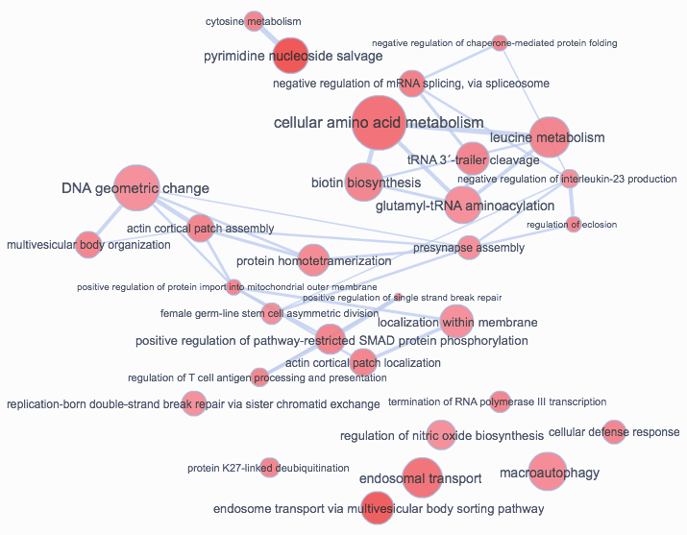
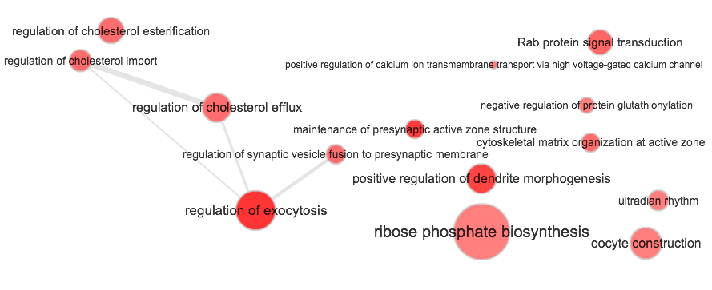
Results: biological processes significantly affected by silo at 23C
Down-regulated process (clade 1):
Up-regulated process (clade 2):

Slide 19
Significance

Slide 20
Conclusions and the future

